Slide 1

Scope of Disclosure | TSIP Team
Confidential period | Indefinite
Head of information owner section | Training Division Head
Handling restriction | “No Copying” , “No Printing” “No transferring”, “No re-disclosure” “No circulation” , “Do not duplicate”
Sequence Diagrams

Slide 2



UML 2.5 discussions have been known to cause or induce sleep among participants.
Necessary precautions to prevent injuries due to participants falling off chairs ,resulting from UML-induced stupor is highly advised ☺
Please do not fall off the chair !

Slide 3



Why We Model
Use Cases
Classes Part 1
Classes Part 2
Sequences
Activities
State Machines
Packages
Prep

Slide 4

Behavior : Riding the Lift

Slide 5
Behavior Modeling
Behavioral modeling models how instances may change over time.
Behavior, Event, and Trigger = Behavior Modeling
Behavior is the basic concept for modeling dynamic change.
Behavior may be executed, either by direct invocation or through the creation of an active object that hosts the behavior
*

Slide 6
Behavior Modeling
Behavior may also be emergent, resulting from the interaction of one or more participant objects that are themselves carrying out their own individual behaviors
Dynamic behavior results in events of interest that occur at specific points in time
implicit, occurring on the change of some value or the passage of some interval of time.
explicit, occurring when an operation is called or an asynchronous signal is received
*

Slide 7
Behavior Modeling
Explicit events thus provide the basic mechanism for communication between behaviors, in which an action carried out in one behavior, such as calling an operation or sending a signal, can trigger a response in another behavior
*

Slide 8
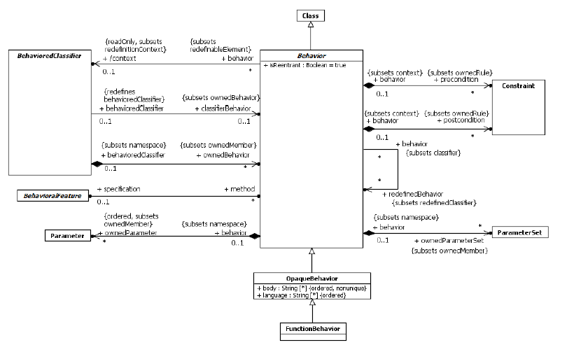
Abstract Syntax

Slide 9
Behavior
A Behavior is a specification of events that may occur dynamically over time
Every Behavior defines at least one event, the event of its invocation
A Behavior may be invoked directly, via a BehavioralFeature that it implements as a method or as the classifierBehavior of a BehavioredClassifier.
On each invocation, the subsequent actual sequence of event occurrences due to the invocation, consistent with the specification of the Behavior, is called an execution trace for the Behavior
*

Slide 10
Behavior
An execution trace always begins with the invocation of the Behavior and may continue indefinitely (if the Behavior does not terminate), or it may end in the occurrence of a termination event for the Behavior, in which case the execution of the Behavior is said to have completed
A Behavior may either complete normally, or it may complete as a result of the raising of an exception, in which case, if the Behavior was invoked synchronously, the exception is propagated to the caller
Event occurrences during an execution trace include :
both occurrences caused by the Behavior, such as attribute value changes, creation and destruction of objects and invocation of other Behaviors, and occurrences that trigger responses within the Behavior, such as the changing of a monitored value or the receipt of a Signal instance.
*

Slide 11
Behavior
Behaviors in UML are kinds of Classes, which means that they may be instantiated as objects
An object that is an instance of a Behavior is known as a behavior execution
Invoking the Behavior corresponds to instantiating the Behavior, and there is a specific execution trace corresponding to each Behavior execution
Since a Behavior is a Class, it may be specialized and may also itself own StructuralFeatures and BehavioralFeatures
An execution of the Behavior may then access these features, such as reading and modifying attributes of the Behavior.
A Behavior may be invoked many times
A reentrant Behavior (i.e., one with its isReentrant property equal to true) may be invoked again before a previous invocation has completed (this is the default).
a non-reentrant Behavior (i.e, one with its isReentrant property equal to false) shall not be invoked again if a previous invocation has not completed
*

Slide 12
Behavior
A reentrant Behavior may have many ongoing executions at any one time, but a non-reentrant Behavior shall have at most one uncompleted execution at any time.
If an invoking Behavior attempts to invoke a non-reentrant Behavior that already has an uncompleted execution, then the invoker shall block until the existing execution completes (or indefinitely, if the execution never completes).
A Behavior may be invoked synchronously or asynchronously
Synchronous invocation means that an invoking Behavior retains a reference to the invoked Behavior execution and waits for the execution to complete
Asynchronous invocation, on the other hand, means that the invoked Behavior execution proceeds concurrently with the invoking Behavior
The preconditions for a Behavior define conditions that shall be true when the Behavior is invoked
The postconditions for a Behavior define conditions that will be true when the invocation of the Behavior completes successfully
*

Slide 13
Behavioral Parameters
A Behavior may have Parameters that provide the ability to pass values into and out of Behavior executions.
When a Behavior is invoked, argument values may be provided corresponding to Parameters with direction “in” or “inout”, as constrained by the multiplicity of those Parameters
If such an input Parameter has a defaultValue, and no explicit argument value is given for it, then the defaultValue is evaluated to provide argument values for the Parameter
When a Behavior execution completes, it may produce result values corresponding to Parameters with direction “inout,” “out,” and “return,” as constrained by the multiplicity of those Parameters
If the Behavior was invoked synchronously, then result values are returned to the invoker. However, if the Behavior was invoked asynchronously, then any result values are lost when the Behavior execution completes.
*

Slide 14
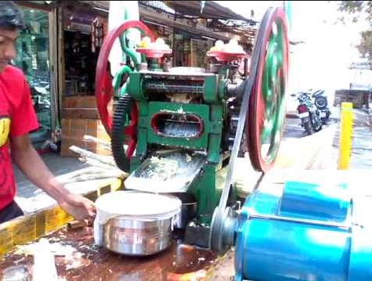
Streaming : Sugarcane Crusher

Slide 15
Behavior
Parameters may also be marked as streaming (i.e., have the isStreaming property be true). Such Parameters allow values to be passed into and out of a Behavior execution any time during its course, rather than just on invocation and completion.
If an input Parameter is streaming, then argument values may be provided for the Parameter during the course of a Behavior execution rather than just at invocation
One or more argument values may be posted to a streaming input Parameter at or any time after the invocation of a Behavior and before its completion
If an output Parameter is streaming, then a Behavior execution may provide result values for the Parameter during its course rather than just at completion.
One or more result values may be posted to a streaming output Parameter any time after the invocation of a Behavior up to or at its completion
A reentrant Behavior shall not have streaming Parameters
because there are potentially multiple executions of the Behavior going at the same time, and it would be ambiguous which execution would be receiving or producing streamed values
A Behavior may have one or more output Parameters marked as isException=true.
In this case, when an execution of the Behavior completes, either none of these Parameters shall have values or exactly one shall have a value and no other parameters (exception or otherwise) shall have any values.
*

Slide 16
Behavior
A Behavior with input ParameterSets can only accept inputs from Parameters in one of the sets per execution.
A Behavior with output ParameterSets can only post outputs to the Parameters in one of the sets per execution.
An OpaqueBehavior is a Behavior whose specification is given in a textual language other than UML.
An OpaqueBehavior has a body that consists of a sequence of text Strings representing alternative means of specifying the required behavior
FunctionBehavior is an OpaqueBehavior that does not access or modify any objects or other external data
FunctionBehaviors thus represent functions that transform a set of input argument values (given by the input Parameters of the FunctionBehavior) to a set of output result values (given by the output Parameters of the FunctionBehavior).
Examples of functions that might be modeled as FunctionBehaviors include primitive arithmetic, Boolean, and String functions
*

Slide 17
Behavior
A BehavioredClassifier is a Classifier that may have ownedBehaviors, at most one of which may be considered to specify the behavior of the BehavioredClassifier itself
A BehavioredClassifier may have a distinguished ownedBehavior called its classifierBehavior.
A classifierBehavior describes the behavior an instance of the owning Classifier may undergo in the course of its lifetime.
The classifierBehavior of a BehavioredClassifier is considered to be invoked when an instance of the owning BehavioredClassifier is created and the resulting execution has the new instance as its context object.
The execution is terminated if the instance is destroyed
Calling an Operation on or sending a Signal instance to an object of a Class is a request for the object to carry out an identified BehavioralFeature
There are two kinds of BehavioralFeatures
Operations : An Operation call identifies a specific operation to be invoked
Receptions : The receipt of an instance of a Signal, is considered to be a request for any Reception of the receiving object that references that Signal or any direct or indirect generalization of it
Note : Of the different kinds of BehavioredClassifiers in UML, only Classes may have BehavioralFeatures and only active Classes may have Receptions
*

Slide 18
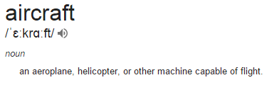

Slide 19
Behavior
A BehavioralFeature of a Class may be implemented by one or more method Behaviors
A Behavior shall be the method for no more than one BehavioralFeature, called its specification
The specification of a Behavior shall be an owned or inherited member of the Class of which the Behavior is an ownedBehavior.
It is possible to have more than one method associated with a single BehavioralFeature, but there shall be at most one Behavior for a particular pairing of a Class (as owner of the Behavior) and a BehavioralFeature (as the specification for the Behavior).
This means that a single BehavioralFeature may have methods both in its owning Class and any direct or indirect subclass of that Class, but with no more than one method per Class
The receiving object becomes the context object for the execution of any invoked methods

Slide 20
Behavior
Methods of a Reception are always invoked asynchronously, while the methods of an Operation may be invoked either synchronously or asynchronously, depending on how the Operation is called.
Simple object-oriented resolution process for a CallEvent that always results in at most one method being identified:
If the Class of the receiving object owns a method for the Operation identified in the CallEvent, then that method is the result of the resolution.
Otherwise, the superclass of the Class of the receiving object is examined for a method for the Operation, and so on up the generalization hierarchy until a method is found or the root of the hierarchy is reached.
If a Class has multiple superclasses, then all of them are examined for a method.
If no method is found, or a method is found in more than one ancestor Class along different paths, then the model is ill-formed for this resolution process and it results in no method.
A method of an Operation shall have Parameters corresponding to the Parameters of the Operation. Similarly, a method of a Reception shall have Parameters corresponding to the attributes of the Signal referenced by the Reception, which are considered as effective “in” Parameters of the Reception

Slide 21
Events
An Event is a something that may occur at a specific instant in time.
One Event may have many occurrences, which may happen at different times.
an Event can be considered a classification of its occurrences
though Events are not actually Classifiers in UML
Of particular importance are Events that trigger a response within a Behavior
TimeEvents that occur at a specified time or after a duration
ChangeEvents that occur when a specified Boolean value becomes true
MessageEvents that occur on the receipt of a message, which is a communication from one Behavior to another requesting an Operation call or Signal reception

Slide 22
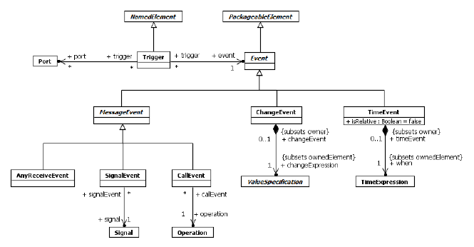
Events

Slide 23
Events
An Event is the specification of some occurrence that may potentially trigger behavioral effects
A Trigger specifies a specific point in the definition of a Behavior at which an Event occurrence may have such an effect
Event is a PackageableElement, allowing Events to be modeled independently of their use
A single Event may be used in several different Triggers.
a Behavior execution always has an associated context object. A context object mediates the handling of Event occurrences for all of its associated Behavior executions

Slide 24
Events
When an Event occurrence is recognized by a context object, it may have an immediate effect or it may be saved for later triggered effect
An immediate effect is manifested by direct invocation of a Behavior as determined by the Event, such as the invocation of the method of a BehavioralFeature
A triggered effect is manifested by the storage of the occurrence in the event pool of the object and the later consumption of the occurrence by an ongoing Behavior execution that reaches a Trigger that matches the Event corresponding to the occurrence in the pool
When a Behavior execution comes to a wait point where it needs a Trigger to continue, the event pool of its context object is examined for an event that satisfies the outstanding Trigger (or Triggers).
If the pool contains an event occurrence that satisfies one of the Triggers, the occurrence is removed from the pool and dispatched to the Behavior, which continues its execution as specified.
*

Slide 25
Message Events
A message is a communication in which a sender makes a request for either an Operation call or Signal reception by a receiver
This communication involves two events: the event of sending the message and the event of receiving the message.
A message contains:
• Data associated with the request being made
(arguments for Operation parameters or values for Signal attributes).
• Information about the nature of the request \
(i.e., the BehavioralFeature invoked).
• For a synchronous invocation, sufficient information to enable the return of a reply from the invoked Behavior.
While each message is targeted at exactly one receiver object and caused by exactly one sending object, an occurrence of a sending event may result in a number of messages being generated (as in SignalBroadcastAction).

Slide 26
Events
The receipt of a message is manifested as a MessageEvent occurrence
A CallEvent is a MessageEvent for messages requesting that a specific Operation be called
A SignalEvent is a MessageEvent for messages requesting the reception of an instance of a specific Signal.
An AnyReceiveEvent is a MessageEvent for any message that is not explicitly handled by any other related Trigger.
In the case of a CallEvent for an Operation or a SignalEvent for a Signal that matches a Reception on the receiver, if the Operation or Reception has one or more methods, then the method resolution process for Behavioral Features and Methods shall be carried out to determine a method to be used to handle a MessageEvent occurrence
If a method is so identified, it is invoked to respond to the message request. Otherwise, the MessageEvent occurrence is saved in the event pool of the receiving object.
When a MessageEvent occurrence is dispatched from the event pool and matches a Trigger defined in the Behavior specification for the receiver, it causes the execution of a response within the Behavior.

Slide 27
Events
A Trigger for an AnyReceiveEvent may be triggered by the receipt of any message (Signal send or Operation call). However, if there is a relevant SignalEvent or CallEvent Trigger that specifically matches the message, then the AnyReceiveEvent Trigger is not triggered by the message
A ChangeEvent occurs when a Boolean changeExpression becomes true. For example, this could be as a result of a change in the value of some Attribute or a change in the value referenced by a link corresponding to an Association
A ChangeEvent occurs implicitly and is not the result of any explicit action.
A TimeEvent specifies an instant in time at which it occurs
If the TimeEvent is absolute, then the time resulting from the evaluation of the TimeExpression is the absolute time at which the TimeEvent occurs.
If the TimeEvent is relative, then the TimeEvent shall be used in the context of a Trigger, and the time of occurrence is relative to a starting time determined for the Trigger.

Slide 28
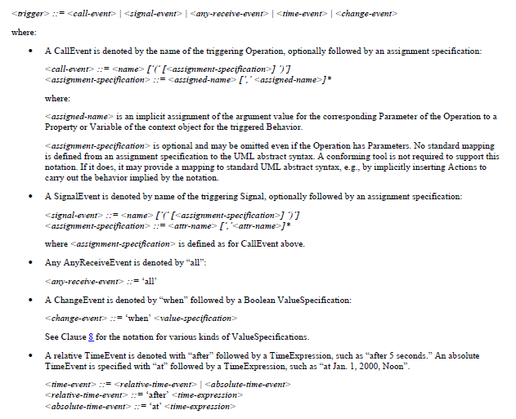
Trigger Notation

Slide 29
Interactions

Slide 30
Interactions
A trace means “sequence of event occurrences”
<eventoccurrence1, eventoccurrence2, ...,eventoccurrence-n>
Interaction specifications place partial ordering constraints on allowed and disallowed traces
A partial order restricts the order in which events can (or cannot) occur in any given system trace
An interaction can be displayed in several different types of diagrams: Sequence Diagrams, Interaction Overview Diagrams, and Communication Diagrams
Optional diagram types such as Timing Diagrams and Interaction Tables come in addition
Normally some other legal and possible traces are not contained within the described interactions

Slide 31
Interactions
By interleaving we mean the merging of two or more traces such that the events from different traces may come in any order in the resulting trace, while events within the same trace retain their order. Interleaving semantics is different from a semantics where it is perceived that two events may occur at exactly the same time
Interactions are kinds of Behaviors that model emergent behaviors
The execution of a Behavior results in an execution trace. Such a trace is a sequence of event occurrences, will be denoted <e1, e2, . . . , en>. Each event occurrence may also include information about the values of all relevant objects at the point of time of its occurrence
The semantics of an Interaction are expressed in terms of a pair [P, I], where P is the set of valid traces and I is the set of invalid traces
P ! I need not be the whole universe of traces

Slide 32
Interactions
The set of valid traces is constrained by a partial ordering of the event occurrences in the traces
The set of invalid traces is also constrained by a partial ordering of the event occurrences in the trace.
In an interaction diagram each vertical line describes the time-line for a process, where time increases down the page.
The distance between two events on a time-line does not represent any literal measurement of time, only that non-zero time has passed.
The instances in an interaction in principle operate independently of each other.
No global notion of time is assumed.
The only dependencies between the timing of the instances come from the restriction that a message must be sent before it is received

Slide 33
Interactions
Along each instance axis the time is running from top to bottom, however, a proper time scale is not assumed
If no coregion or parallel operator is introduced, a total time ordering of events is assumed along each instance
Events of different instances are ordered via messages, or via the generalized ordering mechanism
A message must first be sent before it is consumed
With the generalized ordering mechanism "orderable events" on different instances (even in different interactions) can be ordered explicitly

Slide 34
Interactions
Sequence Diagrams : focuses on the Message interchange between a number of Lifelines
Communication Diagrams : show interactions through an architectural view where the arcs between the communicating Lifelines are decorated with description of the passed Messages and their sequencing
Interaction Overview Diagrams : define interactions in a way that promotes overview of the control flow ; Overview diagrams have notational elements that are similar to certain elements used in Activity diagrams (flow lines, forks, joins, etc.);
Timing Diagrams : show interactions when a primary purpose of the diagram is to reason about time

Slide 35
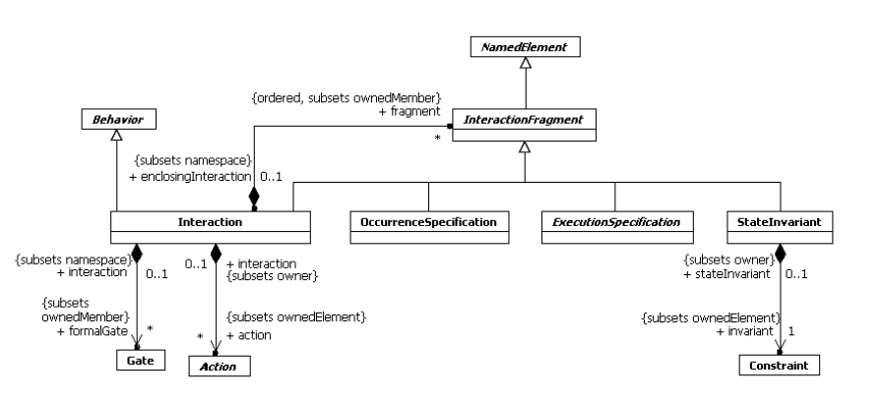
Interactions

Slide 36
Interactions
Interactions are units of behavior of an enclosing Classifier.
Interactions focus on the passing of information with Messages between the ConnectableElements of the Classifier
The semantics of an Interaction is given as a pair of sets of traces.
The two trace sets represent valid traces and invalid traces.
The union of these two sets need not necessarily cover the whole universe of traces
A trace is a sequence of event occurrences, each of which is described by an OccurrenceSpecification in a model
The invalid set of traces is associated with the use of :
Negative CombinedFragment : invalid set of traces is explicitly specified
Assertion CombinedFragment : implicitly specifies the set of invalid traces by explicitly specifying the only valid set of traces
* For simplicity we describe only valid traces for all other constructs

Slide 37
Interactions
As Behavior an Interaction is generalizable and redefineable
Specializing an Interaction is simply to add more traces to those of the original. The traces defined by the specialization is combined with those of the inherited Interaction with a union
The classifier owning an Interaction may be specialized, and in the specialization the Interaction may be redefined
A formal Gate may be attached to the inner boundary of an Interaction to provide a link point to establish the concrete sender and receiver through an InteractionUse of that Interaction.
Interaction Fragments : semantics of an InteractionFragment is a pair of set of traces.
may either be contained directly in an enclosing Interaction, or may be contained within an InteractionOperand of a CombinedFragment.
may be multiple nesting levels of InteractionFragments within an Interaction

Slide 38
Interactions
Occurrence Specifications : the semantics of an OccurrenceSpecification is just the trace of that single OccurrenceSpecification.
Execution Specifications : The trace semantics of Interactions merely see an Execution as the trace <start, finish>. There may be occurrences between these.
Typically the start occurrence and the finish occurrence will represent OccurrenceSpecifications such as a receive OccurrenceSpecification (of a Message) and the send OccurrenceSpecification (of a reply Message).
State Invariants : The Constraint is assumed to be evaluated during runtime. The Constraint is evaluated immediately prior to the execution of the next OccurrenceSpecification.
If the Constraint is true, the trace is a valid trace; if the Constraint is false, the trace is an invalid trace.
In other words all traces that have a StateInvariant with a false Constraint are considered invalid

Slide 39
Notations
The notation for an Interaction in a Sequence Diagram is a solid-outline rectangle. A pentagon in the upper left corner of the rectangle contains ‘sd’ followed by the Interaction name and parameters.
An Interaction diagram may also include definitions of local attributes with the same syntax as attributes in general are shown within class symbol compartments. These attribute definitions may appear near the top of the diagram frame or within note symbols at other places in the diagram.
InteractionFragment : There is no general notation for an InteractionFragment
OccurrenceSpecification : OccurrenceSpecifications are merely syntactic points at the ends of Messages or at the beginning/end of an ExecutionSpecification.

Slide 40
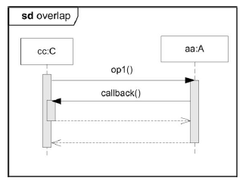
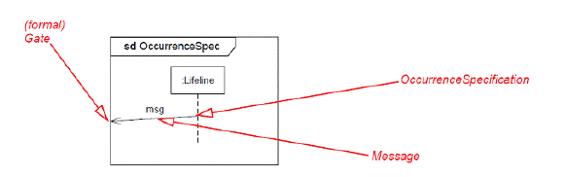
Notations
ExecutionSpecification
ExecutionSpecifications are represented as thin rectangles (gray or white) on the lifeline
Overlapping ExecutionSpecifications on the same lifeline are represented by overlapping rectangles

Slide 41
Notations
StateInvariant
The possible associated Constraint is shown as text in curly brackets on the lifeline
A conforming tool may show a StateInvariant as a Note associated with an OccurrenceSpecification
The state symbol represents the equivalent of a constraint that checks the state of the object represented by the Lifeline. This could be the internal state of the classifierBehavior of the corresponding Classifier, or it could be some external state based on a “black-box” view of the Lifeline.
The value of the constraint is true if the specified state information is true.

Slide 42
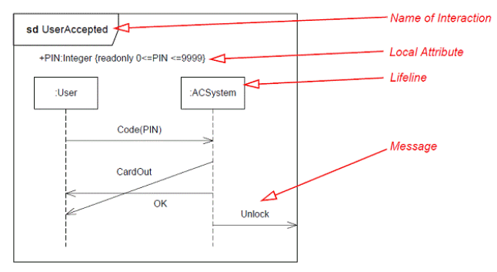
Examples

Slide 43
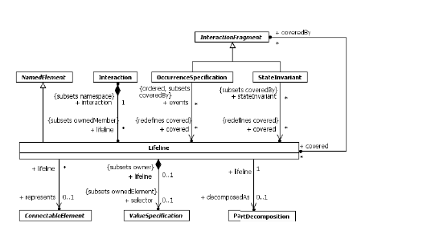
Lifelines

Slide 44
Lifelines
Lifeline describes the time-line for a process, where time increases down the page
The distance between two events on a time-line does not represent any literal measurement of time, only that non-zero time has passed
Events on the same time-line are ordered linearly down the page, except where they occur within a parallel combined fragment, or along a lifeline within a “coregion”.
Within a parallel combined fragment or a coregion, events are not locally ordered unless that is directly imposed by a general ordering construct
The order of OccurrenceSpecifications along a Lifeline is significant denoting the order in which these OccurrenceSpecifications will occur.
The absolute distances between the OccurrenceSpecifications on the Lifeline are, however, irrelevant for the semantics.
The semantics of the Lifeline (within an Interaction) is the semantics of the Interaction selecting only OccurrenceSpecifications of this Lifeline.

Slide 45
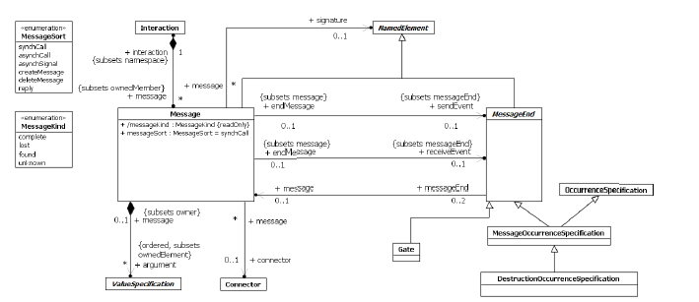
Messages

Slide 46
Messages
The semantics of a complete Message is simply the trace <sendEvent, receiveEvent>.
A lost Message is a Message where the sending event occurrence is known, but there is no receiving event occurrence.
destination of the [lost]Message is outside the scope of the description
semantics is simply the trace <sendEvent>
A found Message is a Message where the receiving event occurrence is known, but there is no (known) sending event occurrence
origin of the Message is outside the scope of the description
semantics is simply the trace <receiveEvent>
The signature of a Message refers to either an Operation or a Signal
If the Message signature is an Operation, then the Message represents one of the following:
If the messageSort is either synchCall or asynchCall, then the Message represents the synchronous or asynchronous call to and start of execution of the Operation
If the messageSort is reply, then the Message represents the return from a synchronous call to the Operation

Slide 47
Messages
If the Message signature is a Signal, then the messageSort must be asynchSignal, and the Message represents the asynchronous sending and reception of an instance of the Signal. The arguments of the Message correspond to the attributes of the Signal.
An argument of a Message is a ValueSpecification. If the Message has a signature and it is not a reply Message, then its argument ValueSpecifications are considered to be evaluated at the point of the send event of the Message. Their results provide the values for the corresponding Operation input parameters or Signal attributes
An argument consisting of an Expression with no operands and the empty string as its symbol has a special interpretation as a wildcard, corresponding to an unspecified but legal value for the corresponding parameter or attribute
If the Message is a reply, then each of its arguments must be an Expression with at most one operand.
The symbol of the argument Expression of a reply Message represents the assignment target for the argument, to which the returned value for the argument is to be assigned
Unknown : An empty string, which represents an unknown assignment target
Interaction Parameter: The unqualified name of an ownedParameter of the enclosing Interaction, which must be an out, inout or return Parameter
Attribute. The (possibly qualified) name of an attribute of the context Behavior of the enclosing interaction or of the receiving Lifeline of the Message (which is the lifeline that sent the original message to which this is a reply).

Slide 48
Messages
Message Occurrence Specifications represents a send event or a receive event associated with a message between two Lifelines
Destruction Occurrence Specifications represents the destruction of the instance described by the lifeline that contains it. It may result in the subsequent destruction of other objects that this object owns by composition
Gates is a MessageEnd which is used on the boundary of an Interaction, or an InteractionUse, or a CombinedFragment to establish the concrete sender and receiver for every Message
Gates are MessageEnds which provide a connection point between, either:
• a Message instance outside of an InteractionUse and a Message instance inside the used Interaction, or;
• a Message instance outside a CombinedFragment and a Message instance inside a
InteractionOperand within the CombinedFragment
MessageOccurrenceSpecifications are partially ordered by the following rules:
• MessageOccurrenceSpecification instances are ordered on their owned Lifeline
• MessageOccurrenceSpecification instances are ordered across a Message instance. A sending MessageOccurrenceSpecification instance is ordered before the receiving MessageOccurenceSpecification instance
*A formal Gate associated with an Interaction provides a link point attached to the inside boundary of that Interaction, to convey a Message inside that Interaction

Slide 49
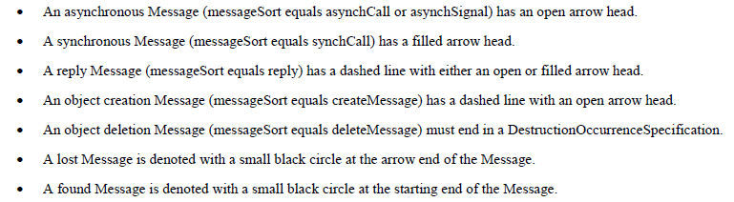
Notation
Message
A message is shown as a line from the sender MessageEnd to the receiver MessageEnd
The line must be such that every line fragment is either horizontal or downwards when traversed from send event to receive event
The send and receive events may both be on the same lifeline.
The form of the line or arrowhead reflects properties of the message :

Slide 50
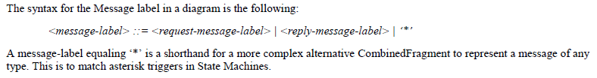
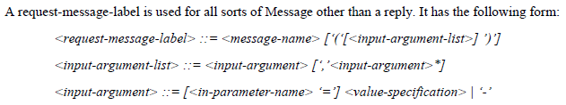
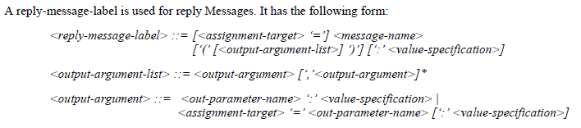
Notation

Slide 51
Notation
If the Message has a signature, this will be the name of the Operation or Signal referenced by the signature
If a request-message-label includes an input-argument-list, then either all input-arguments must have an in-parameter-name given or none may have one.
If in-parameter-names are not given, then the input-arguments denote the arguments of the Message, in order, with a hyphen (‘-’) denoting a wildcard argument
If the Message has a signature, then the arguments are matched, by order, to the in and inout ownedParameters of an Operation or the attributes of a Signal. An argument must be provided for every such parameter or attribute
A reply-message-label may optionally have an assignment-target given to the left of the message-name, with a corresponding returned value denoted by the optional value-specification given after a colon at the end of the reply-message-label
DestructionOccurrenceSpecification depicted by a cross in the form of an X at the bottom of a Lifeline
Gate are just points on the frame, the ends of the messages. They may have an explicit name

Slide 52
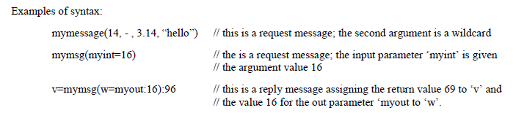
Examples

Slide 53
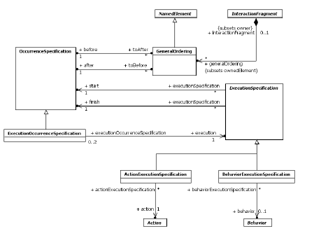
Occurences

Slide 54
Occurences
Behavior Execution Specifications used for interactions specifying messages that result from behaviors
ExecutionOccurrenceSpecification represents, on a lifeline, the start event or the end event of an ExecutionSpecification
GeneralOrdering restricts the set of possible sequences. A partial order of OccurrenceSpecifications is constrained by a set of GeneralOrderings
An ExecutionOccurrenceSpecification is represented by the start or finish endpoint of the vertical box for an ExecutionSpecification on a lifeline
A GeneralOrdering is shown by a dotted line connecting the two OccurrenceSpecifications. The direction of the relation from the before to the after is given by an arrowhead placed somewhere in the middle of the dotted line (i.e., not at the endpoint).

Slide 55
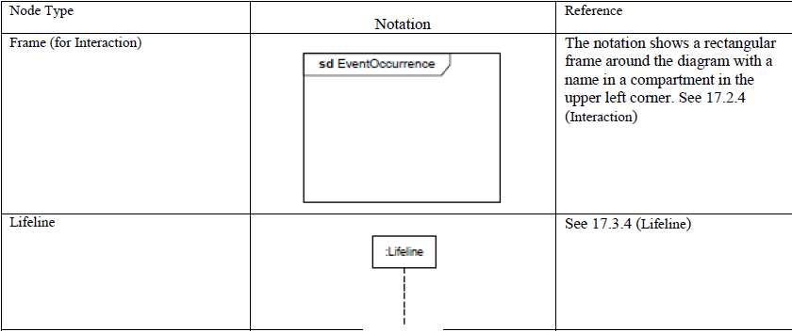
Sequence Diagram : Notation

Slide 56
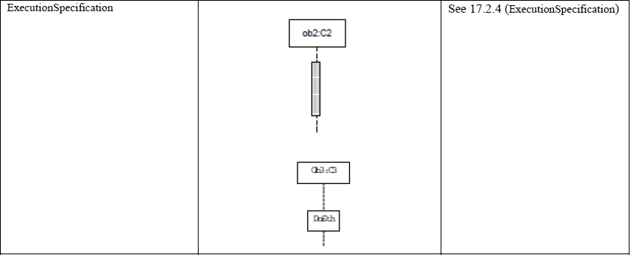
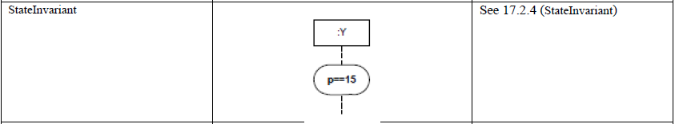
Sequence Diagram : Notation

Slide 57
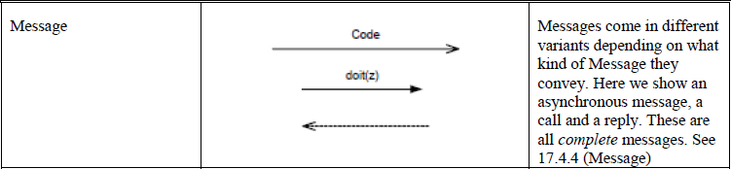
Sequence Diagram : Notation

Slide 58
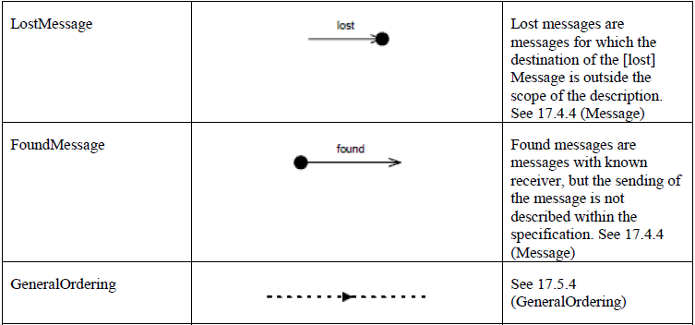
Sequence Diagram : Notation

Slide 59
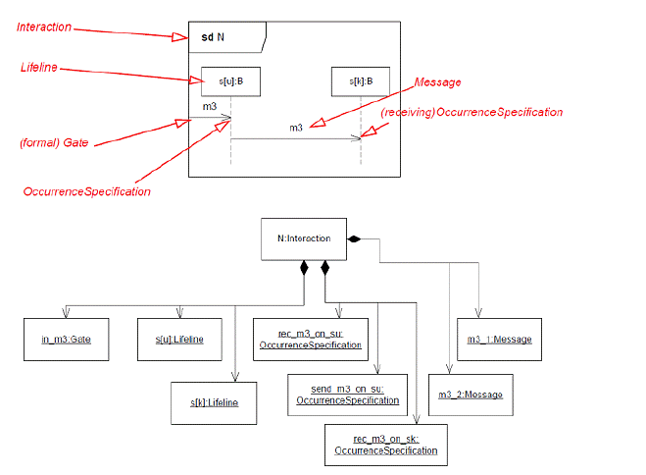
Example

Slide 60
Summary
BehaviorExecutionSpecification is a kind of ExecutionSpecification representing the execution of a Behavior.
DestructionOccurenceSpecification models the destruction of an object
ExecutionOccurrenceSpecification represents moments in time at which Actions or Behaviors start or finish
ExecutionSpecification is a specification of the execution of a unit of Behavior or Action within the Lifeline. The duration of an ExecutionSpecification is represented by two OccurrenceSpecifications, the start OccurrenceSpecification and the finish OccurrenceSpecification
Gate is a MessageEnd which serves as a connection point for relating a Message which has a MessageEnd (sendEvent / receiveEvent) outside an InteractionFragment with another Message which has a MessageEnd (receiveEvent / sendEvent) inside that InteractionFragment
GeneralOrdering represents a binary relation between two OccurrenceSpecifications, to describe that one OccurrenceSpecification must occur before the other in a valid trace. This mechanism provides the ability to define partial orders of OccurrenceSpecifications that may otherwise not have a specified order

Slide 61
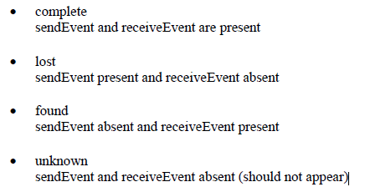
Summary
Interaction is a unit of Behavior that focuses on the observable exchange of information between connectable elements.
Lifeline represents an individual participant in the Interaction
Message defines a particular communication between Lifelines of an Interaction
MessageEnd is an abstract specialization of NamedElement that represents what can occur at the end of a Message
MessageKind is enumerated type that identifies the type of Message

Slide 62
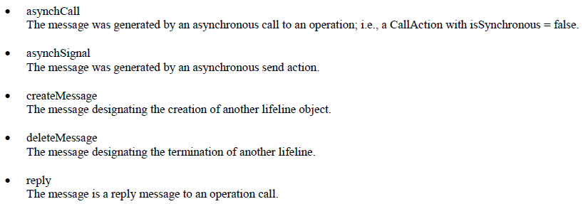
Summary
MessageOccurrenceSpecification specifies the occurrence of Message events, such as sending and receiving of Signals or invoking or receiving of Operation calls. A MessageOccurrenceSpecification is a kind of MessageEnd. Messages are generated either by synchronous Operation calls or asynchronous Signal sends. They are received by the execution of corresponding AcceptEventActions
MessageSort : enumerated type that identifies the type of communication action that was used to generate the Message

Slide 63
Summary
OccurrenceSpecification is the basic semantic unit of Interactions. The sequences of occurrences specified by them are the meanings of Interactions
StateInvariant is a runtime constraint on the participants of the Interaction. Used to specify a variety of different kinds of Constraints, such as values of Attributes or Variables, internal or external States, and so on

Slide 64
Annexure
(outside the syllabus for Foundation Exam)

Slide 65
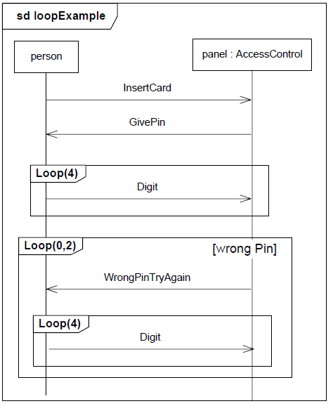
loop

Slide 66
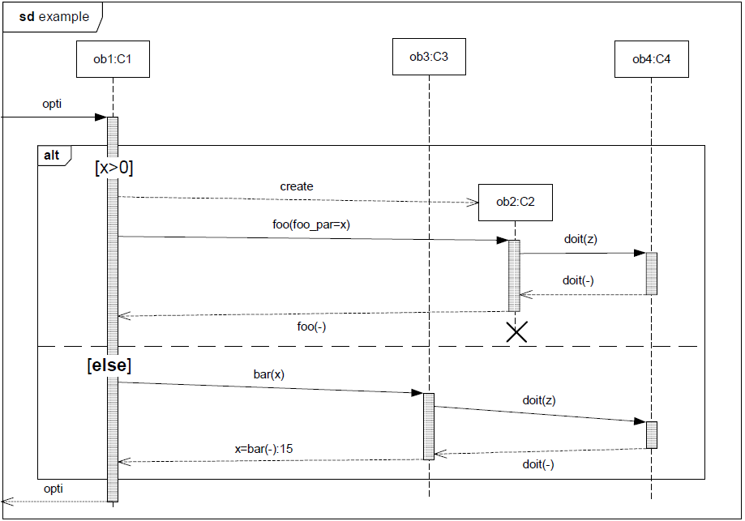
alt [case]

Slide 67
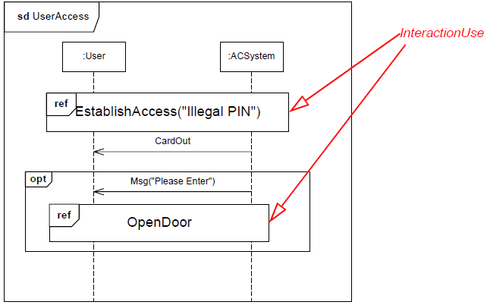
opt [if]

Slide 68
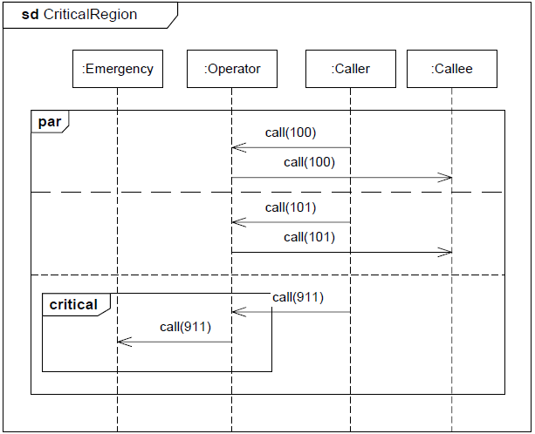
Critical Region /Parallel

